Slide 1



User-defined Functions
A guide in/for Python
Notes:
Welcome back! In our final video in this tutorial series, we will be discussing user-defined functions, but what are user-defined functions?
Well, first, let’s recap on what a function is. A function is a set of statements that takes inputs, performs specific tasks, and returns an output. Python has a series of built-in functions, such as the print function, but we can also create our own functions, and these are known as user-defined functions. So, let's try it out!

Slide 2


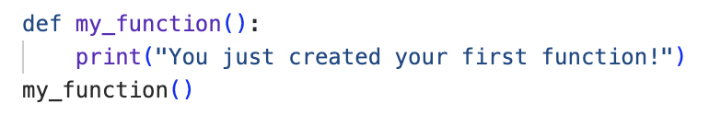
Creating a Function
Notes:
Now, a user-defined function is written by using the keyword def, followed by an assigned function name (in this case, ‘my function’), followed by parentheses, followed by a colon, followed by an indented block of statements (in this example, the print statement).
Here, when we call our function, the output ‘You just created your first function!’ is returned.

Slide 3
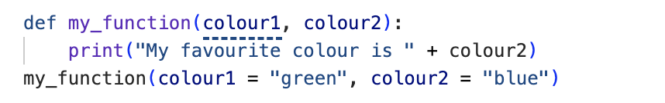
Keyword Arguments
Notes:
Building on this, a function may take one argument or many arguments, also called parameters, as inputs. These parameters must be enclosed within the parentheses just after the function name. In this example, our function takes two arguments (‘colour1’ and ’colour2’), printing ‘My favourite colour is ’ the colour assigned to colour2.
Here, when we call our function with colour1 assigned as green and colour2 assigned as blue, the output ‘My favourite colour is blue’ is returned.

Slide 4
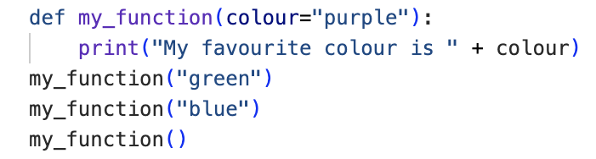
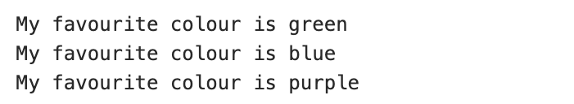
Default Values
Notes:
We can also set a default argument, which is a parameter that assumes a default value if a value is not otherwise provided in the functional call for that argument. In this example, colour is set by default to purple. This means that if the function is called without providing a value for the argument colour, the output returned will be “My favourite colour is purple’, as shown here.

Slide 5
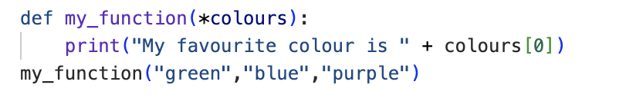
Arbitrary Arguments
Notes:
Similarly, when we don’t know how many arguments might be given to a function, we can use arbitrary arguments. Such arguments are written with an asterisk followed by a suitable group name (in this case, colours). In this example, the function returns ‘My favourite colour is ’ the first colour given to the function.
Here, when we call our function with the colours ‘green’, ‘blue’ and ‘purple’, the output ‘My favourite colour is green’ is returned.

Slide 6
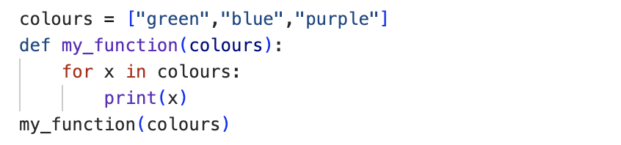
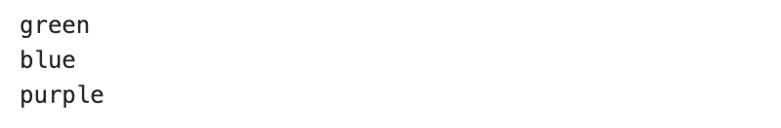
Passing a List
Notes:
Taking the learning from our previous tutorials, we can also create functions that implement for loops and if statements. In this example, we pass the function a list of colours. Note, as the ‘colours’ argument in the function is being passed a list, even though the number of arguments within the list might change, colours does not need to be passed as an arbitrary argument in the function call.
Here, when we pass the list of colours, the function iterates through the list and prints each colour in the order as given by the list, returning the output ‘green’, ‘blue’, ‘purple’.

Slide 7
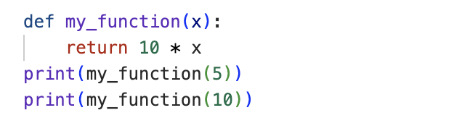

Return Values
Notes:
Sometimes, we might want to return the result of the function to be used in further processes. This can be achieved by using a return statement, which ends the execution of the function call and ”returns” the result or the value of the expression following the keyword return (in this case 10 multiplied by the value of x) to the caller. Here, when the value 5 is passed to the function, the value 50 is returned when the function is printed. Likewise, the value 100 is returned when the value 10 is passed. In this code, we call the function within a print function to extract the return value. However, you can also assign the returned value of a function to a new variable.
It is also important to note that if no expression is given following the keyword return, then the special value None is returned.

Slide 8
Challenge Yourself
Write a function that returns only the fruits from a given list of food of apple, banana, bread, pear, and pizza.
Print the output of this statement.
Notes:
And that’s this lesson on user-defined functions complete. Now we would like to give you the opportunity to challenge yourself by trying the assignment set on this slide.
Answers will be discussed in the following slide, so make sure to pause this video now while you work through the task.

Slide 9
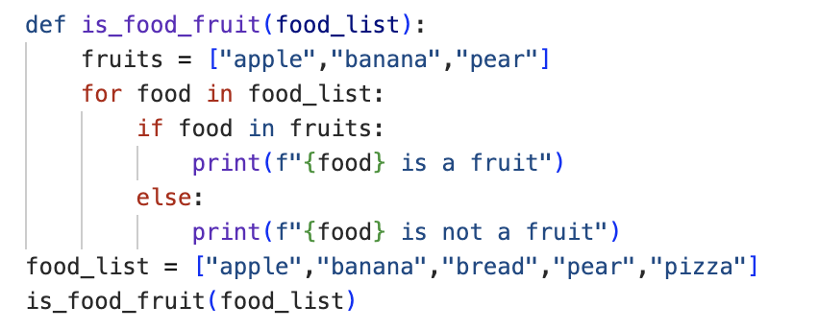

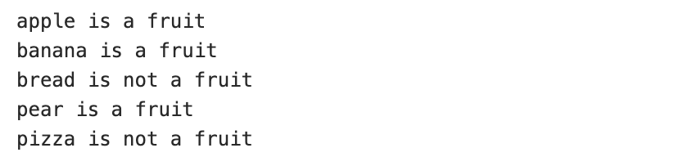
Notes:
We asked you to try writing a function that outputs only the fruits from a given list of food ‘apple’, ‘banana’, ‘bread’, ‘pear’, and ‘pizza’, so our code declares a function using the keyword def within which we use an if statement within a for loop. When called, the function returns the output as above. Each item in the fruit list (in this case, ‘apple’, ‘banana’, and ‘pear’) is noted as ‘is a fruit’ and all remaining food items (in this case, ‘bread’ and ‘pizza’) are noted as ‘is not a fruit’.
How did you find this? If you got it right, congratulations! If not, that’s okay. We don’t always get things right on the first try. There’s still plenty of time to learn, and the teaching staff will be happy to work through any problems with you. Just give us a shout!
Otherwise, we look forward to seeing you in class.

